Slide 1


Situation-driven strategy development and innovation management for SMEs and other organizations
A strategy which results in congruent, implementable actions plans for growth, profit, service excellence and sustainable innovation.
Linking corporate objectives with group and individual responsibilities
Traditional strategy development but with an emphasis on innovation management and making strategy happen!

Slide 2
Situation-driven strategy development and innovation management
Table of Contents
Three steps to developing a practical, implementable strategy while addressing innovation management.
  Step One; understand the organization’s strategic/innovation situation
  Step two; select a strategy
  Step three; make it happen
http://www.corporateinnovationonline.com
Researching and articulating innovation management best practices

Slide 3
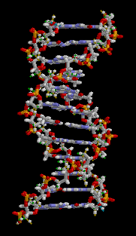
Introduction
Key Components of a Situation-driven strategy
- A full understanding of competitors’ strategy and approach to innovation
Industry developments and societal trends
The corporation’s spectrum and depth of innovation compared to the competition or other benchmark
Cultural assessment as a precursor to implementation
Congruency checks to rigorously integrate proposed actions with strategic direction
Risk assessment related to change

Slide 4
How does innovation management change strategy?
By knowing the innovation spectrum; i.e. breadth and depth, of the competition, the organization is in a better position to understand the priorities for strategic development and achieving sustainable innovation and growth
By articulating the approach to innovation management, priorities are identified and investment decision making is improved
Risk assessment for key decision making is more easily quantifiable

Slide 5
Characteristics of the methodology
Background research on industry and competition
SME/organization provided data
External interviews as required
Internal interviews
Use of on-line survey as required
Workshops for each of the three steps
Board and broad consultation as required
Implementation involvement as required
Proven methodology and understood by all participants
Fully interactive with senior management

Slide 6
Three steps
Step One; Establishing SME’s/organizations Strategic Situation and Innovative Capacity
Step Two; Selecting a Strategy
Step three; Making strategy happen by using KRAs

Slide 7
Summary of the full process
Step One; understand the company’s strategic/innovation situation
Gather intelligence and analyze. Define the industry and the business segment
Understand competitive intensity
SWIOT analysis
The spectrum of innovation at Starbucks
Understand the key success factors (BofC)
relative to the competition
Characterize the strategic/innovation situation
Step Two; select a strategy
Selecting a Strategy
Evaluating alternate strategies for the business unit, leading to the preparation of action plans
Think about ‘natural’ strategic option zones based on the strategic situation
Selecting a Strategy
Risk analysis is based on many elements
Step Three; make it happen
Making strategy happen by making use of KRAs
The implementation of action plans requires a consideration of many factors
Understand group key results areas and individual responsibilities
A format for individual establishing ‘Key Result Areas’

Slide 8
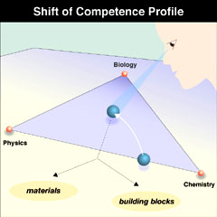
Step One
Establishing SME’s Strategic Situation and Innovative Capacity

Slide 9
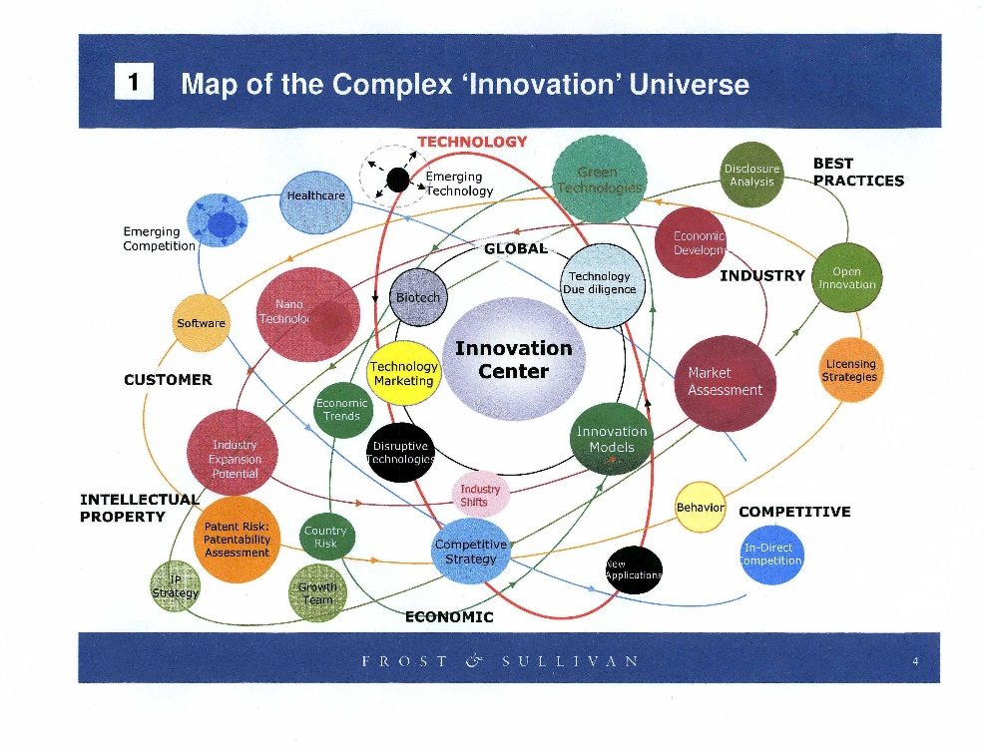
Establishing SME’s Strategic Situation and Innovative Capacity; Step one.
Gather intelligence and analyze
Define the industry and the business segment
Size of industry
Growth over time, price trends
Key influences on industry growth
Competition
Organizational nature of the competition
Innovation spectrum of the competition
Product line concept
Basis of competition
Barriers to entry
Facilities factors
Financial operating characteristics
Role of technology
Constraints

Slide 10
Establishing SME’s Strategic Situation and Innovative Capacity; Step one.
Understand competitive intensity
Courtesy of Michael E. Porter, Competitive Strategy
Risk is much higher in intensely competitive environments
Potential Entrants
Threat of New Entrants
Bargaining Power of Buyers
Industry
Competitors
Rivalry Among
Existing Firms
Suppliers
Buyers
Bargaining Power of Suppliers
Threat of Substitute Products or Services
Substitutes

Slide 11
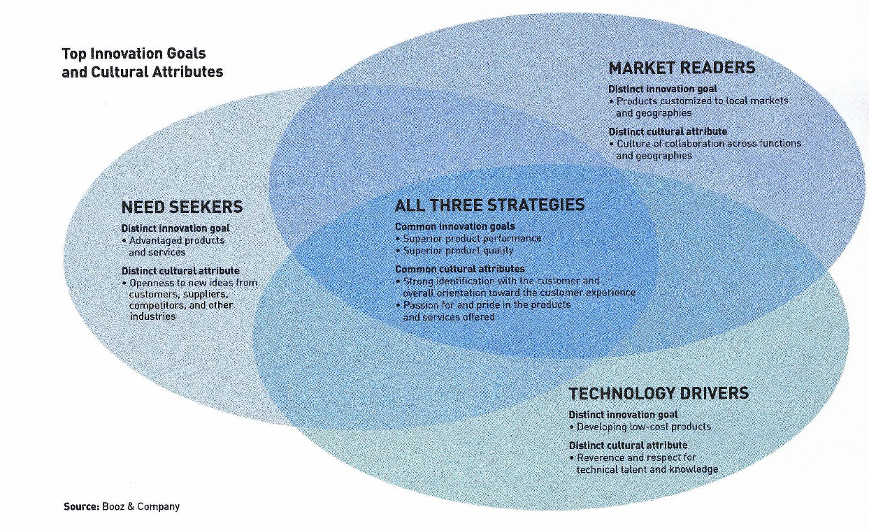
Establishing SME’s Strategic Situation and Innovative Capacity; Step one.
SWIOT analysis
Picture attributed to Booz and Company
Strengths – traditional approach
Weaknesses – traditional approach
Innovation spectrum; breadth and depth – new!
Opportunities – traditional approach
Threats – traditional approach

Slide 12

Establishing SME’s Strategic Situation and Innovative Capacity; Step one.
An example
The spectrum of innovation at Starbucks
Starbucks had made the point that it wishes to be the ‘coffee authority’, meaning that it needs to have, at all times, a definitive and deep knowledge – know how - of the complete supply chain for coffee. The company needs to be the best in the business.
Roasting and processing coffee is at the heart of the technology of Starbucks business.
There is both a science component and much art associated with the process of making an exceptional brew.
The combination of the science and the art is the ‘know how’ of the business and this is what Starbucks has brought to the market along with effective sourcing and a flair for retail marketing. Basic to the success of Starbucks is that it is, in the minds of millions of customers, a good tasting brew; and better than most!

Slide 13
Establishing SME’s Strategic Situation and Innovative Capacity; Step one.
The spectrum of innovation
Industry/market/customer-centric 'Innovation interest' with minimal risk
Technology 'Innovation interest' with nominal risk
'Innovation interest' in common-use technologies to keep up to date.
'Innovation interest' in a defined market in order to differentiate product/service.
R&D 'Innovation interest' with higher risk
Applied Science/
Fundamental science
'Innovation interest' in emerging technologies.
"Innovation interest ' in research
Business process continuous improvement
Product line extensions
New business models
New products

Slide 14
Starbucks Innovation Profile An example of the spectrum of innovation
Type of Innovation | Evidence of Innovation by Type of Innovation | Comment
Science
Fundamental Science | None | Not expected in this industry
Applied Science | VIA development based on the chemistry of ‘freeze-dried’ technology/ Roast curve relationship | Unusual depth for this industry
Technology
Research | R&D spending as a % of sales/ Intent to be the ‘coffee authority’: maintaining a watchful eye on developments/‘Know how’ | Coffee is in Starbucks DNA
Emerging technologies | ? | Unclear
Differentiating technologies | Quality of product/ R&D to develop less expensive soluble powders [e.g. VIA]/ Sandwiches without a cheese smell/ Ethically-sourced coffee/ Merging coffee with a ‘place’ | Combination of ‘technologies’ provides the differentiation
Common-use technologies | Loyalty program/ Clover equipment/ Mastrena equipment to improve quality, speed, and view | Keeping up to date with technology
New business models | Store design/ Integrating coffee roasting with sales and with both bean and drink | Fundamental shifts in the industry
New products | Store design [seating, Wi-fi, comfort/‘Street-named’ stores/ Coffee quality and price/ Pike Place Roast/ Frappucino/ Coffee – ‘bold’/ Sandwiches/ Branding realization [e.g. Digital Ventures]/ VIA/ Renaming coffee to designate taste rather than bean | Probably the strongest Starbucks type of innovation
Product extensions | Store openings/ Coffee variations/ Sandwich selections/ Coffee but in out-of-store locations/ Limited release reserve coffees | This type of innovation has propelled growth
Business/continuous improvement | IT/ In-store information systems/ Mastrena = speed | Came as an afterthought after Starbucks decline
Innovation refers to the experimentation and adoption of new ideas of all kinds.
Inherent in an idea is always the notion of change; grand or small, and the assumption of risk. Without risk, there is no innovation!
The term ‘innovation interest’ is used to note that not all innovations are physical but can be emotional and may at times be simply thoughts which do not translate, for many reasons, into actions or new products/services.

Slide 15
Note; Establishing SME’s Strategic Situation and Innovative Capacity; Step one.
Measures to move forward
Some external measure – a comparison - is necessary to make realistic the chosen strategy. For every type of organization, there is a source for making comparisons.
Whether a ‘for profit’ or ‘not for profit’ organization, it is useful to have another organization or set of performance factors to compare with your own organization
.
For industry; choose a competing organization with a well-known reputation for innovation. Use survey of customer/employee opinions.
For ‘not for profits’; choose a similar organization which is renowned for its effectiveness. Use a survey of users of the service.
For government; check out the various sources of good governance.

Slide 16

Establishing SME’s Strategic Situation and Innovative Capacity; Step one.
Understand the key success factors (Basis of competition) relative to the competition. Example is from a manufacturing company.
Basis of Competition
Company A
Company B
Company C
Low cost manufacturing
+
0
-
Response time to customer order
- -
+
++
Notes:
In some cases it may be useful to provide relative weights to each of the bases.
If there is likely to be a shift to a different bases in the future, a second set of bases should be developed.
Product Quality
0
+ +
-
Innovative capacity
++
+
-
Product functionality
-
-
-
Sales force training
-
+
--
Overall result
-1
+4
-3
Your company?

Slide 17
Establishing SME’s Strategic Situation and Innovative Capacity; Step one.
Characterize the strategic/innovation situation
Issues to be addressed
Industry dynamics for the business segment
SWIOT analysis
Key success factors
Spectrum of Innovation
Competitive position
Strategic Condition
Competitive intensity
Basis of competition

Slide 18
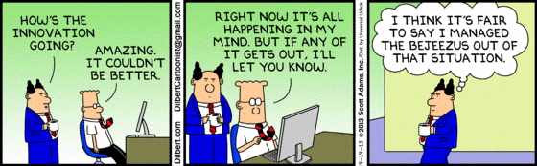
Selecting a Strategy; Step Two
Get it out!

Slide 19
Select a strategy; Step Two
Evaluating alternate strategies for the business unit, leading to the preparation of action plans
Competitive Intensity
Strategic/innovative Situation
Competitive Position
Thrust
Selection
Reference ‘natural’ strategy selection
Potential
Competitor
Reactions
Strategy
Options
Capacity for
Improvements
Risk
Analysis
Strategy
Selection
Financial
Implications
Translation of the
Strategy into Tactical
and Action Plans

Slide 20
Select a strategy; Step Two
Think about ‘natural’ strategic option zones based on the SME’s strategic situation
Stages of Industry Maturity
Competitive Position
Embryonic
Growth
Mature
Aging
Dominant
“Unnatural” strategic thrusts are more risky and often are based on ambition and not on a realization of the company’s ‘strategic/innovative situation’.
Natural Development
Strong
Favorable
Selective Development
Tenable
Prove Viability
Exit Strategy
Weak

Slide 21
Select a strategy; Step Two
Selecting a Strategy
1. Determine the company’s current situation
2. Examine a range of thrusts and strategic options and short list a small number
3. Evaluate the short list of strategic options and select one or two for further development
4. Describe more fully the selected option and its implications. Check the options congruence with overall corporate goals
5. Develop action plans which will make it happen!

Slide 22

Select a strategy; Step Two
Risk analysis is based on many elements
Level of Risk
Elements of Risk
Low
Medium
High
Industry
Risk is inherent in the development of any strategy and for every assumption.
Decisions taken to act or not act carry a strategic implication and risk.
Risk derives from industry maturity and competitive position but other elements also come into play.
Maturity
Competitive Position
Strategy
Assumptions
Innovation management practices
Past performance of the unit
Past performance of management
Level of future performance required
Overall Risk

Slide 23
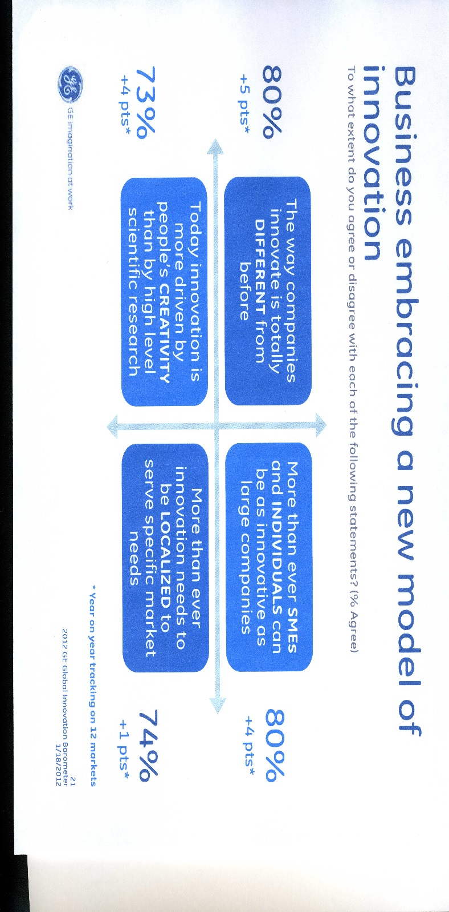
Translating Strategy into Action by Groups and Individuals; Step Three

Slide 24
Translating Strategy into Action by Groups and Individuals; Step Three
Making strategy happen by making use of KRAs
The ‘Management Team’ is involved in all aspects of the work and at all levels in the organization.
SME
Goals
SME
Strategy
Implementation requires compatibility between strategy and organization.
Alignment of individual actions with the chosen strategy is the key to performance improvement
Individual
‘Benchmark
Objectives’
Two or three iterations may be required to properly align all the resources within any one organization.

Slide 25
Translating Strategy into Action by Groups and Individuals; Step Three
The implementation of action plans requires a consideration of many factors including, most importantly, the culture of the organization
Development of
Action Plans
Tactical
Strategies
Multi-Year
Organization
Arrangements
Culture for
Innovation*
Management
Systems
Functional
Strategies
Human
Resources
Organization Structure
Critical Driving Forces
Information and Control Systems
Operations
Infrastructure and Support Systems
Marketing
Decentralization of Responsibilities
Management Style
Performance Measurement and Reward Systems
Technology
Financial
Manager - Subordinate
Development of
Key Result Areas
* For more information on a ‘culture for innovation’, visit the web site.

Slide 26

Translating Strategy into Action by Groups and Individuals; Step Three
Understand group key results areas (KRAs) and individual responsibilities
The following questions aim at identifying, for each position, significant key result ‘areas’
In what areas would improved performance significantly and favorably affect company performance? What actions are necessary and by when?
In what areas could poor performance do damage to the company? What actions are necessary and by when?
Examples of ‘statements’
- to achieve the budgeted level of sales; $$$
- to control scrap level; %%%
- to ensure that resource capacity is fully utilized; %%%

Slide 27
Translating Strategy into Action by Groups and Individuals; Step Three
A format for individual establishing ‘Key Result Area’ responsibilities
Six topics to address in the development of a KRA. No matter what ‘format’ is used, the key is to provide a clear understanding amongst the group and between each manager and subordinate.
A. Main Purpose of Job and Congruence with Strategy
B. Position in the Organization
C. Scope of the Job
D. Key Tasks
Output, Costs, Use of Resources, Quality
E. Personnel Activities
F. Limits of Authority
Not a rope to hand yourself!!

Slide 28
The End
CIO hopes that you found this approach to strategy development of interest and can make use of the methodology.
Innovation should be an integral component of the development of any strategy
Further information is available on the web site;
http://www.corporateinnovationonline.com

